Slide 1
Human Computer Interaction
Usability
and
User Experience

Slide 2
Overview
Recap’
Usability
UX or User Experience Design
Group Exercise
Task
Task’s goal vs. Object’s affordances
Quantifying usability

Slide 3
Usability
Usability vs. Functionality
Access vs. Control
Context dependency
Between Cognitive Load and Goal Oriented Behaviour
Dimensions:
Effectiveness
Efficiency
Satisfaction

Slide 4
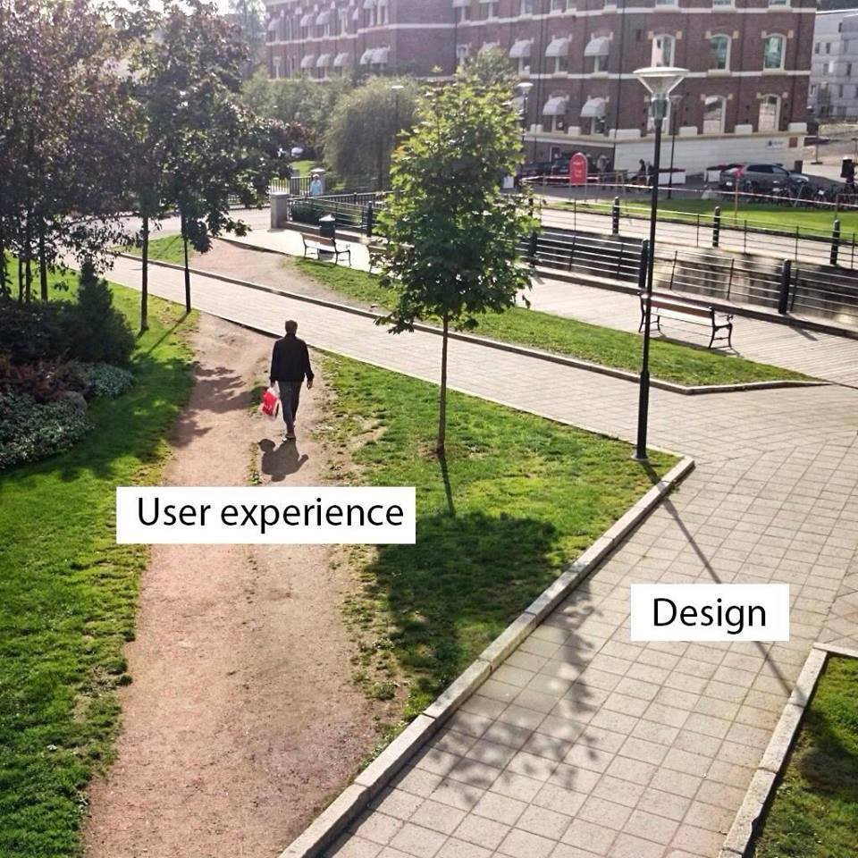
“Design is really an act of communication, which means having a deep understanding of the person with whom the designer is communicating.” ― Donald A. Norman, The Design of Everyday Things

Slide 5
UX: User Experience (Oriented Design)
focuses on the overall feel of the experience
Pragmatic vs. Hedonic
Easy to approach
Easy to learn
Easy to use
Not only Efficient
Also Satisfactory

Slide 6
So what makes a system more:
Intuitive?
Efficient?
Enjoyable?
Notes:
Feedback and adaptability of the system

Slide 7
Donald A. Norman, The Design of Everyday Things
“Good design is actually a lot harder to notice than poor design, in part because good designs fit our needs so well that the design is invisible, serving us without drawing attention to itself. Bad design, on the other hand, screams out its inadequacies, making itself very noticeable.”
“The vicious cycle starts: if you fail at something, you think it is your fault. Therefore you think you can’t do that task. As a result, next time you have to do the task, you believe you can’t, so you don’t even try. The result is that you can’t, just as you thought.”

Slide 8
A Case Study

Slide 9
Taking a user’s perspective:
Individually:
order 2 cinema tickets for the movie PARASITE on Friday evening in downtown Aarhus. I also prefer to site in the back of the room.
Be very attentive to your experience.
Try both platforms listed below:
https://cinemaxx.dk/
https://www.nfbio.dk
Reflect on your experience. If useful, write down the steps you went through and were tou got confused.
In Groups:
Discuss which website you prefered, if any.
Is one system better than the other?
Be as explicit and precise with your explanations.

Slide 10


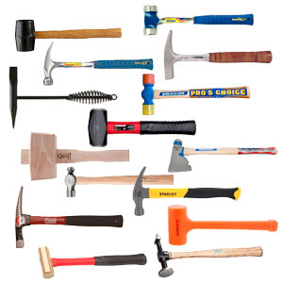
Different use, Different experience
Notes:
Situational
Intention
Gdpr help: lab vs student

Slide 11
When do you check a cinema’s website?
In what kind of different context would you be willing to visit the previous websites?
In Groups:
Consider a different task based on the contexts we discussed.
Revisit the websites.
In your opinion, are they optimised to different use?
Any improvement to suggest to improve overall usability?

Slide 12
How to formalise such research?
Experimental Design(s)?
Tool(s)?
Quantification(s)?

Slide 13
Eye Tracking: visualising
Is that informative in any way?

Slide 14
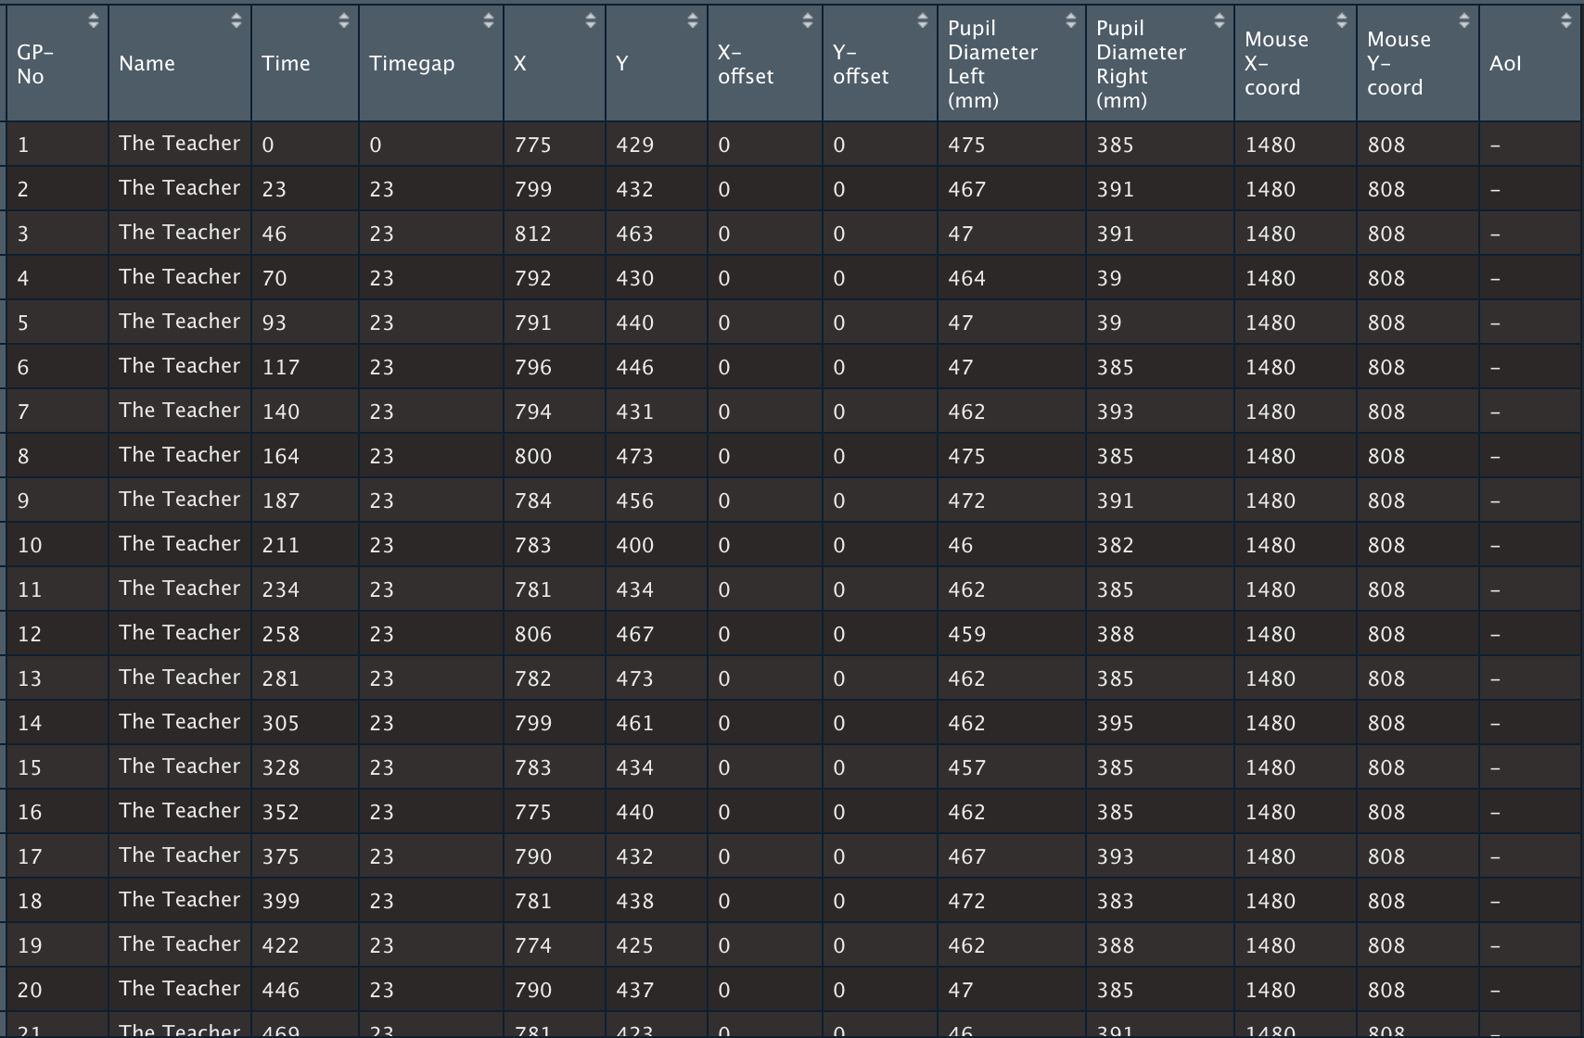
Eye Tracking: raw data and transformation

Slide 15
Eye Tracking
In Groups:
Still in the context of ordering a cinema ticket
discuss ways to uncover meaningful measures of the usability of a system with Eye tracking.
Consider:
Assumptions behind such study
Experimental Design
Data Transformation
Modeling

Slide 16
Eye Tracking: hands on
TBA

